Slide 1
CTD Advanced Training – Day 2
Combinatorial Test Design (CTD)

Slide 2
At the end of this course you learn
Negative Values
Don’t Cares
Weights
Counters
Test Generation
Hands on above using IBM FOCUS Tool.

Slide 3
Negative Testing
What they represent?
  Hard stop of the execution
  Erroneous Input
  Unavailable resources
  Unexpected conditions
Notes:
Sometimes, some values of certain attributes cause processing to take a path that does not exercise any values of some other attributes. For example, a purchase order for an item that does not exist will not exercise any payment method, any means of delivery, and no export control. We call such values Negative Values.
As much as possible, you must make sure that a scenario in a test suite really exercises all the attribute values specified for that scenario.
Typically, negative values represent erroneous input, unavailable resources, and unexpected conditions, but you should keep your eyes open to see other cases as well.

Slide 4
Importance of Testing Error Paths
Occasionally potential harm to the application/system from error path is typically greater.
Can be more difficult to implement, but ignoring them can cause chain reactions of failures.
The number of negative values/combinations in the model depends on the number of error paths/failure conditions of the application.
Notes:
Typically, there are many more error paths than good paths, and in most software, the part that deals with errors is much larger than the part that deals with the good path. Error conditions have the potential to cause systems to crash, and frequently cause much more damage than errors in normal processing. Although it may be harder to create error conditions, by no means should this cause testing of this part of the state space to be weaker.
Testers tend to concentrate on the good paths and neglect the bad paths. Failure scenarios are less intuitive to consider and bad paths can be more difficult to implement, but ignoring them results in field defects that include incomprehensive error messages, unnecessary crashes, and chain reactions of failures.

Slide 5
Identify Negative Combinations
What is Negative value combination?
  Combination of values represent an erroneous input or failing condition
How negative value combination can be defined in IBM FOCUS tool
  Cartesian product
  Negative Combinations Tab
Difference between negative value and negative value combination?
  Hands on defining Negative combinations
Notes:
When a combination of two values result in error conditions then Negative combination can be defined by selecting those values.
Negative value combination can be defined via Cartesian product by projecting the two attributes values which result in error conditions.
Negative value is specific value that cause error condition whereas combination of values which lead to error conditions are called negative combinations

Slide 6
How to Define Negative Testing in IBM FOCUS
Hands on:
  Marking Negative Values
  Identify Negative Combinations
  Good Path and Bad Path
  Interaction Coverage for Bad Path
  Difference between Negative Combinations and Restriction
Notes:
Discuss on the difference between Restriction and Negative value

Slide 7
Weights – Requirements on Values Distribution
We may want to see certain values of an attribute appear significantly more than others in the test plan
  –Resource allocation: we have only 5 machines with Windows versus 500 with Linux
  –Data construction: insurance plan A requires 4 times more new data setup than insurance plan B
  –Priorities: embedded platform is an experimental one, added to the model mainly for documentation purposes
We can instruct FoCuS to take these requirements into account
Note:
–These are only soft constraints (as opposed to interaction coverage requirements)
–May result in a larger test plan
–There is a minimal number of occurrences that a value must have to meet its interaction requirements, regardless of weights requirements

Slide 8
Weights
Numbers that represent distribution of the values
Example:
  Attributes “A”, “B”, “C”
  Weights “1”, “2”, “3”
  Expected result: three times as many Cs, twice as many Bs
If no Weights defined, values are randomly distributed
  It is possible to define weights for all or a subset of the attributes, but all values must be considered
Weights are a “soft constraint” – i.e. no guarantee final result will be perfect
Hands On
Notes:
Weights are whole numbers that represent a requirement for the distribution of the values of a certain attribute in the final test solution.
For example, if there are three values and the weights are 1, 2, and 3, in the output, you would expect to see twice as many of the second than of the first, and three times as many of the third than of the first.
If no weights are defined, then the values are randomly distributed. It is possible to define weights for only part of the attributes, but it is not possible to define weights for only part of an attribute's values.

Slide 9
Don’t Cares
  Don’t cares is used for ignoring certain value combinations while CTD test cases are generated.
  In general it is not recommended.
  Don't care can still appear in the test plan but they are not part of the coverage requirements (as opposed to exclusions which will never appear in the test plan)

Slide 10
Counters
Counters are a special type of attributes
They do not participate in the Cartesian product, but rather get their value according to the values of other attributes
Specifically, they count the number of appearances of selected values in selected attributes
Can be used in restrictions
Notes:
Counters are auxiliary attributes.
It is mainly used in restrictions in order to restrict the occurrence of values with respect to the scenario.

Slide 11

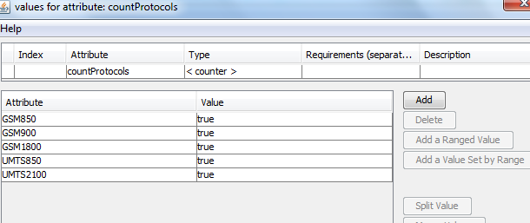
Counters - Example
Notes:
In the example the scenario allows only one or two protocols and more than two protocols are not allowed even though these protocols holds valid for the mobile. Here we are using counters to restrict the occurrence of the protocols.

Slide 12
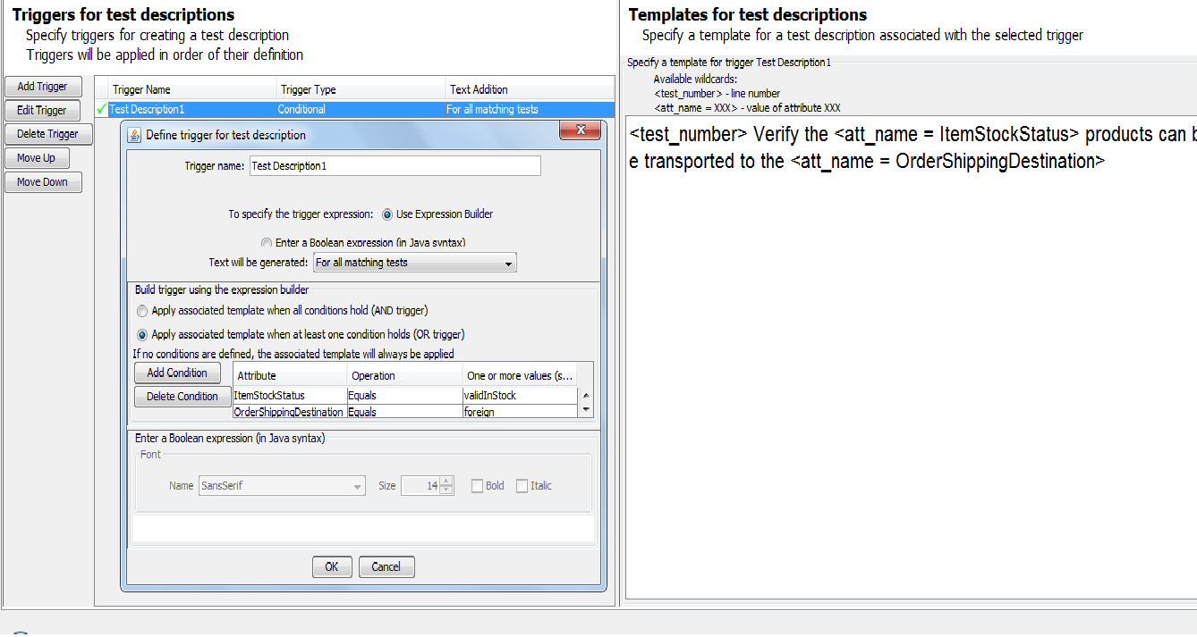

Test Generations
  Free Style Descriptions:
Define Trigger
Template Section
Notes:
cover triggers for descriptions and the new function around test steps here
need to cover also the basic principles in model review, and export/import into testing tools

Slide 13
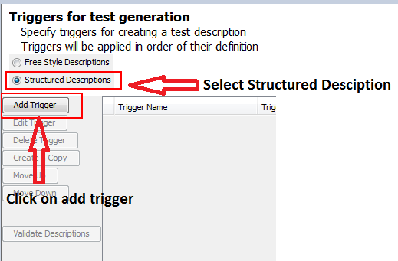
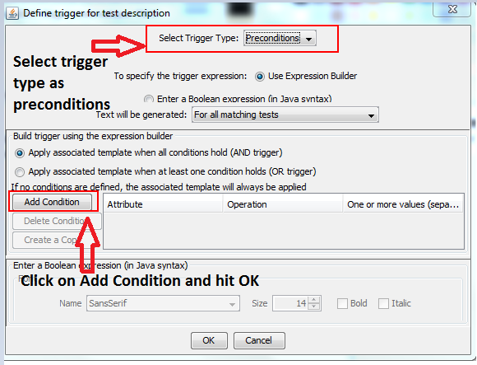
Test Generations
  Structured Descriptions
Step 1: Step 2:
Notes:
Structured description is used for generating the test scenarios in the ALM format.

Slide 14
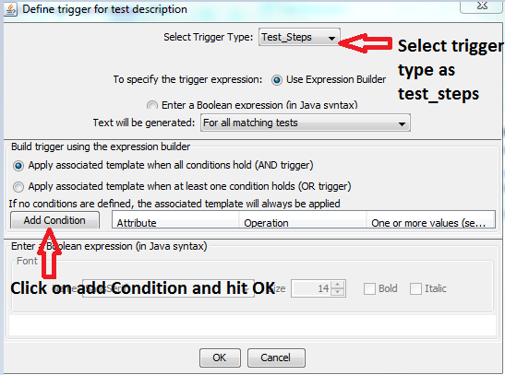
Test Generations
For selecting trigger type as test, repeat step 1 and select trigger type as test steps

Slide 15
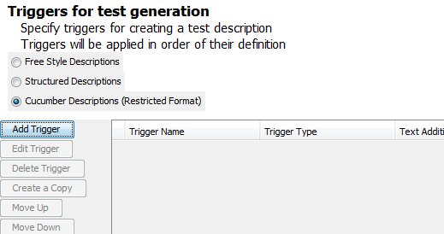
Test Generations – Cucumber Descriptions
Select the Cucumber format

Slide 16
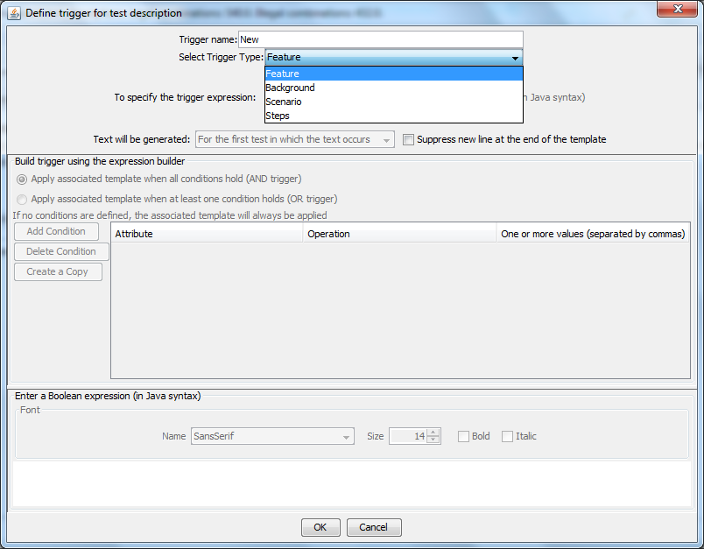
Test Generations – Cucumber Descriptions
Notes:
Add Feature, Scenario and Steps

Slide 17
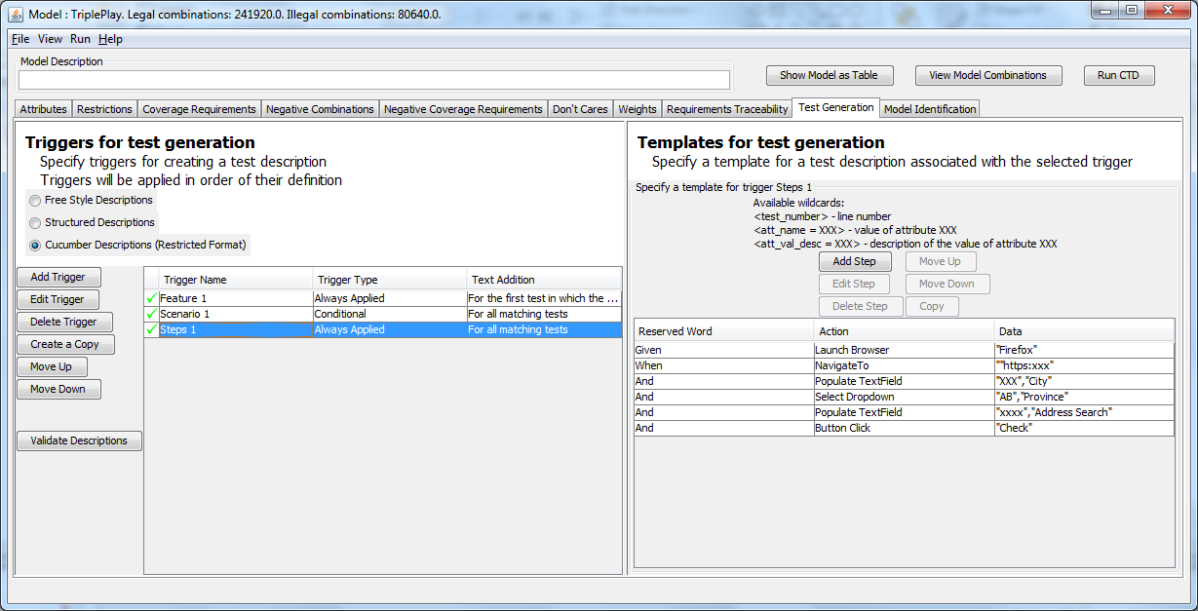
Test Generations – Cucumber Descriptions

Slide 18
Other Features
Model Sanitization
  Sanitization generates a similar model by renaming the existing attributes and values.
Append /Merge Model
  Model can be merged or appended to an existing model
Compare with Another model
  Model can be compared with another model
Input output Model
  A model where in inputs define the output criteria. The attributes are classified as input or output
Interactive Test case outcome Modification
  CTD test case outcome can be modified instantly using Modify Test plan
Derived Exclusions
  Provides the excluded combination with respect to the restrictions provided.
Decision Tree Report
  View Legal and Illegal combinations with respect to value combinations.
Classifying the Attributes
  Attributes can be classified as Input, State, Environment, precondition , persistent, Result, Auxiliary, none.
Requirement Traceability
  Traceability of the requirements with respect to the attribute values

Slide 19


Slide 20


